Slide 1

Android - Kotlin
AllPhi Fleet Management Application

Slide 2


Slide 3
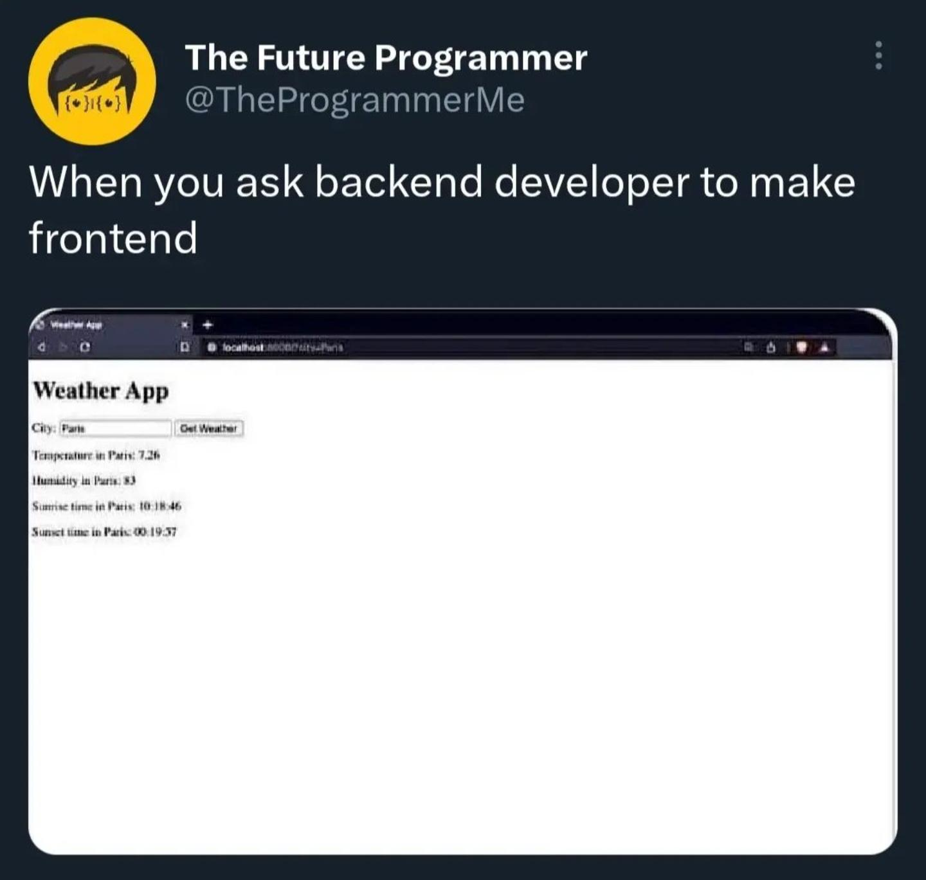

Slide 4
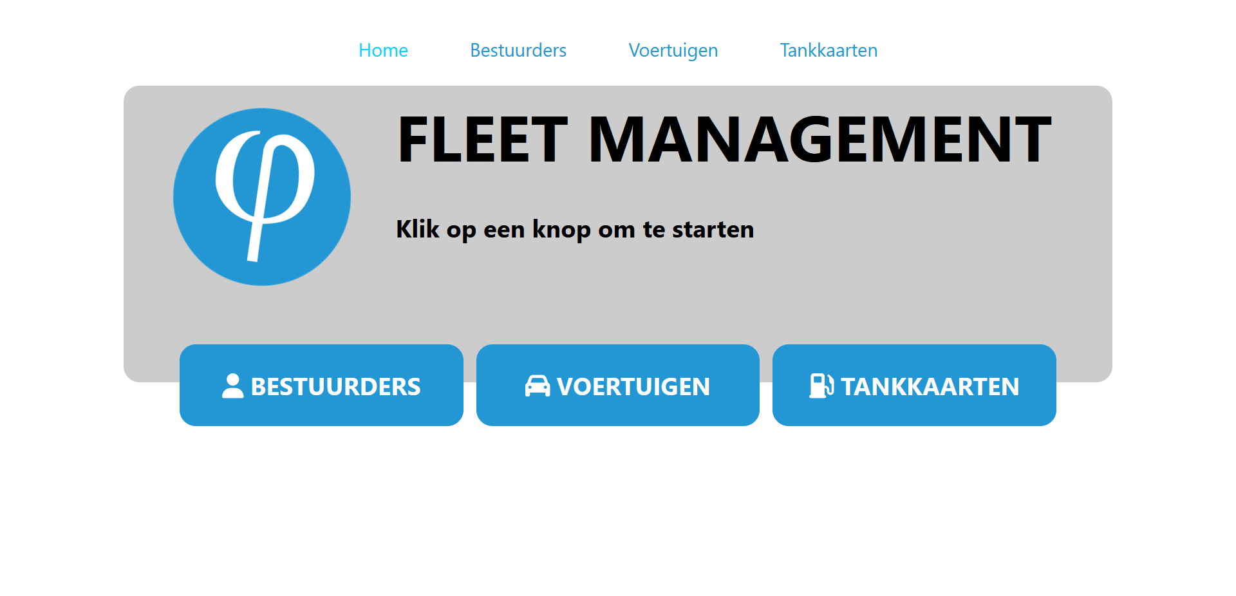

Slide 5
http://affiche.me:8888/
https://affiche.me:8200/api/drivers

Slide 6
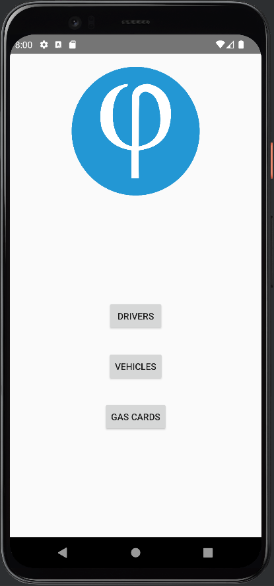
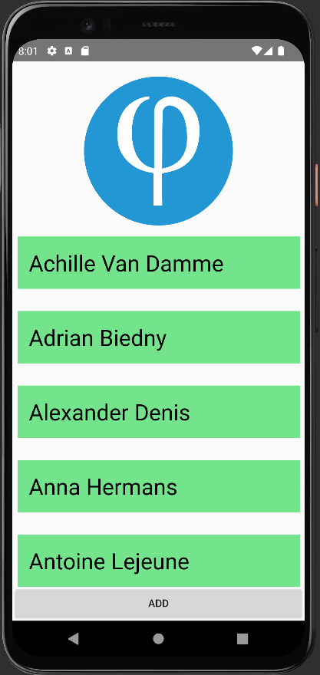
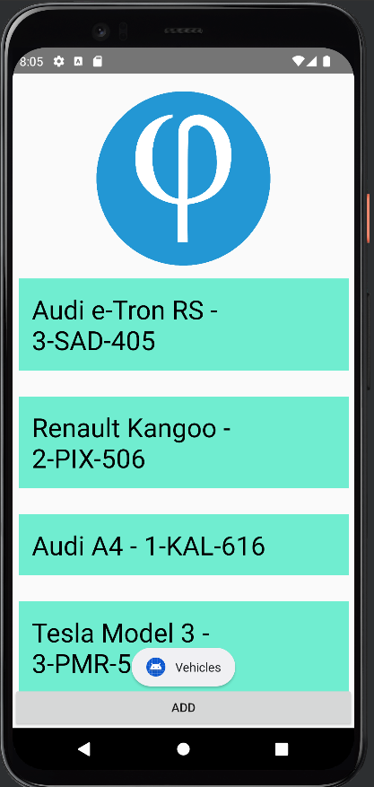
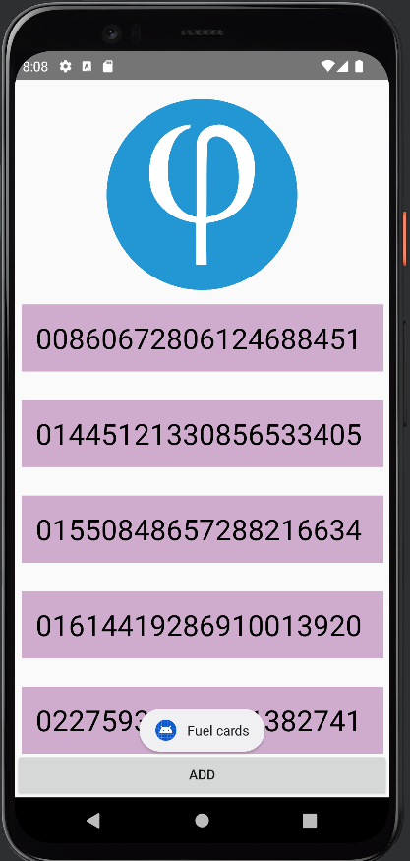

Slide 7
https://github.com/NotAffiche/StolosAPFMA

